Slide 1

Machine Learning
ICT-4261
By-
Dr. Jesmin Akhter
Professor
Institute of Information Technology
Jahangirnagar University

Slide 2
Contents
The course will mainly cover the following topics:
A Gentle Introduction to Machine Learning
Important Elements in Machine Learning
Linear Regression
Logistic Regression
Naive Bayes
Support Vector Machines
Decision Trees and Ensemble Learning
Neural Networks and Deep Learning
Unsupervised Learning

Slide 3
Outline
Neural Networks

Slide 4
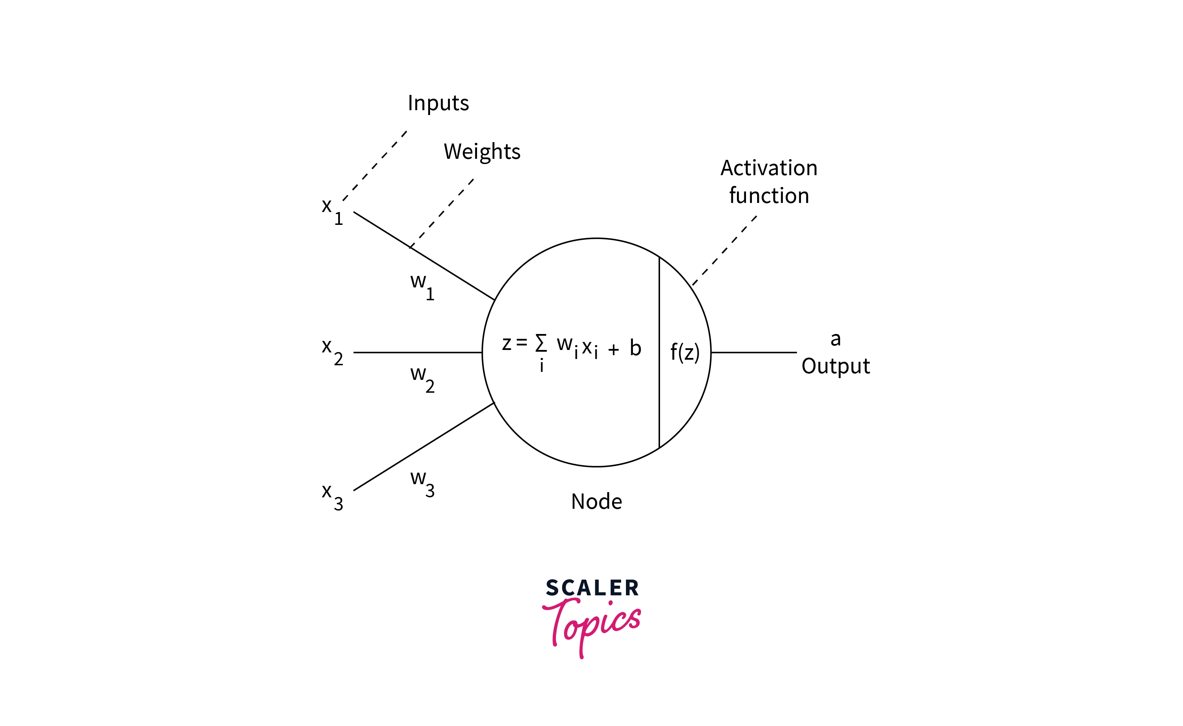

Slide 5
Chain Rule
The chain rule is a mathematical principle that allows the derivative of a composite function to be expressed in terms of the derivatives of the functions that make up the composite. In the context of neural networks feedforward, the chain rule is used to calculate the gradient of the loss function concerning the weights and biases of the neurons in the network. The gradient is calculated by applying the chain rule recursively, starting from the output layer and working backward through the hidden layers to the input layer. The gradient of the loss function concerning weight or bias in a particular layer is given by the derivative of the loss function concerning the output of that layer, multiplied by the derivative of the output of that layer concerning the weight or bias. Once the gradient has been calculated, we can use it to update the weights and biases to minimize the error.

Slide 6
Backpropagating with the Chain Rule
Backpropagation is a technique used to train neural networks feedforward. It propagates the error between the predicted output and the desired target backward through the network to update the neurons' weights and biases. The chain rule is a key part of the backpropagation algorithm, as it allows the gradient of the loss function concerning the weights and biases to be calculated efficiently. Backpropagation consists of feeding the input data through the network, calculating the error, propagating the error back through the network using the chain rule to calculate the gradient at each layer, and updating the weights and biases using the gradient and a specific update rule. This process is repeated for multiple epochs to minimize errors and improve the network's performance.

Slide 7
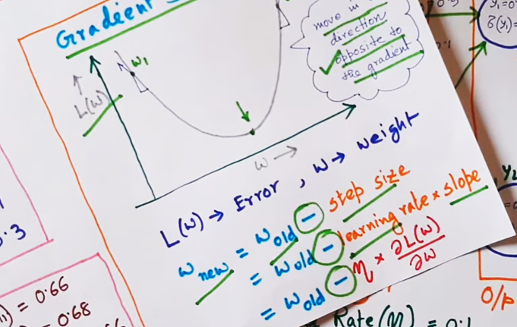

Slide 8
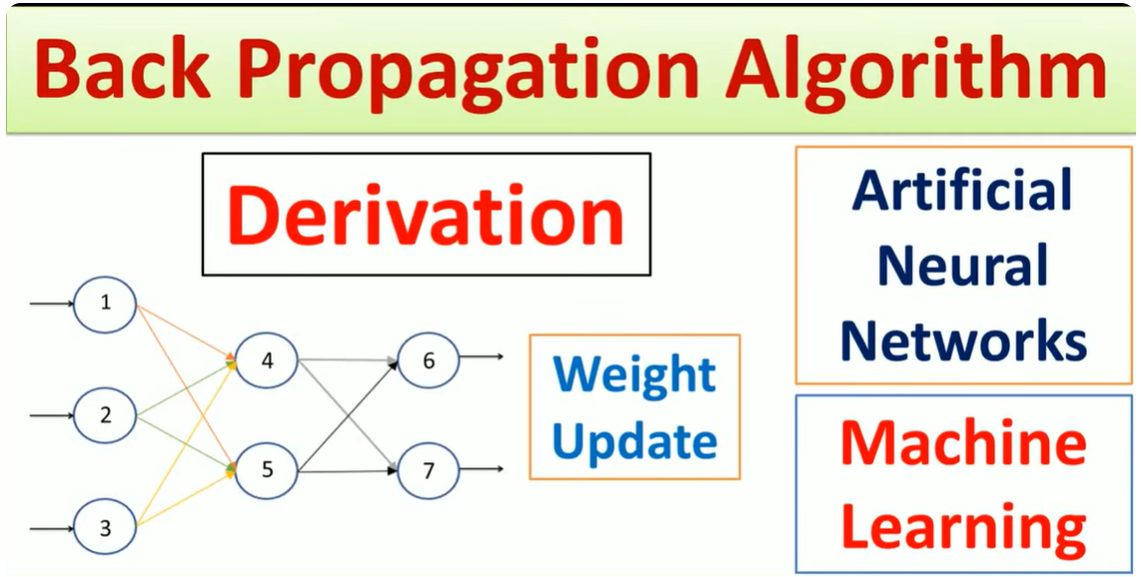

Slide 9
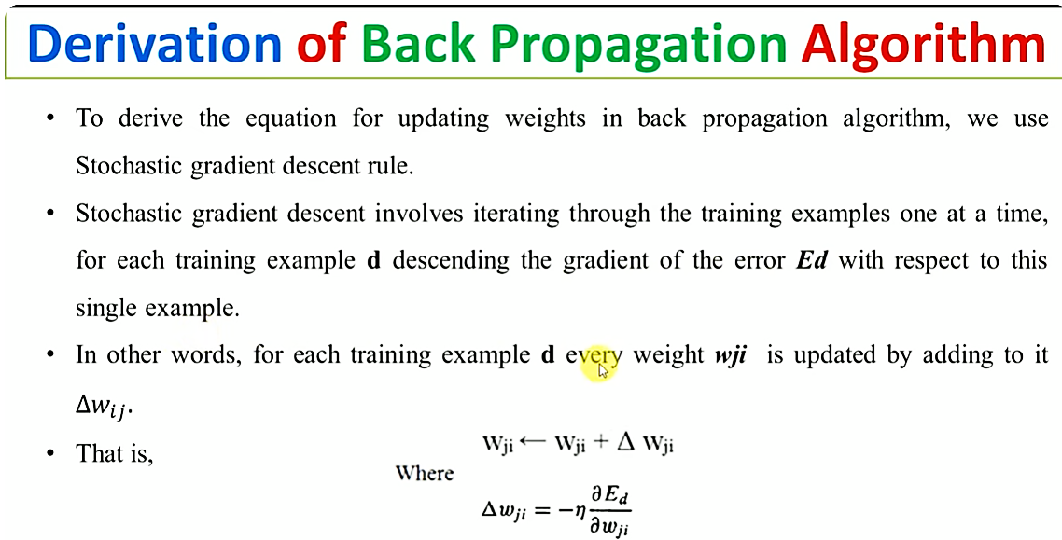

Slide 10
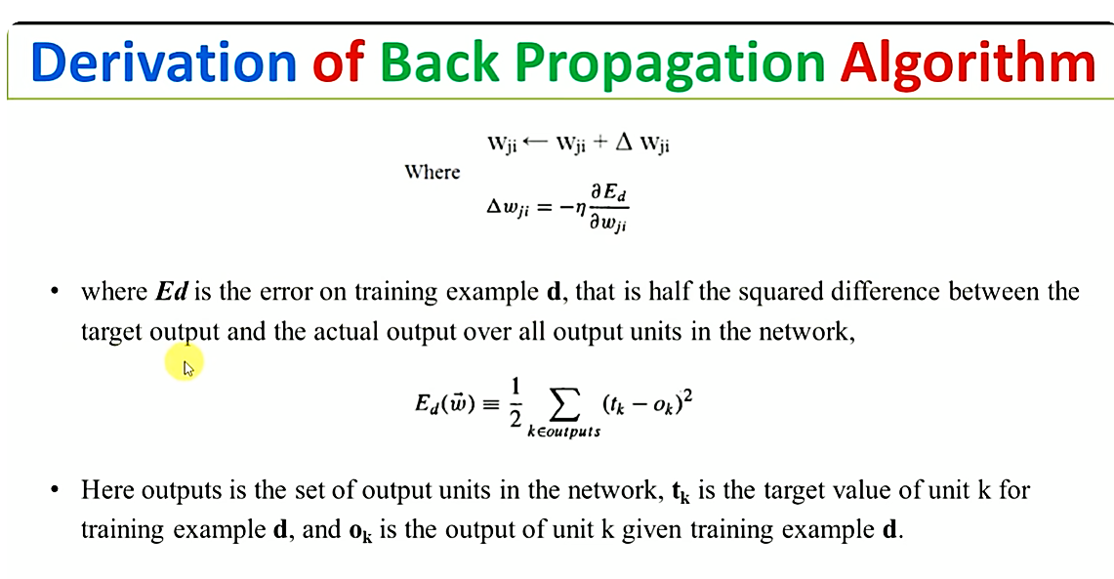

Slide 11
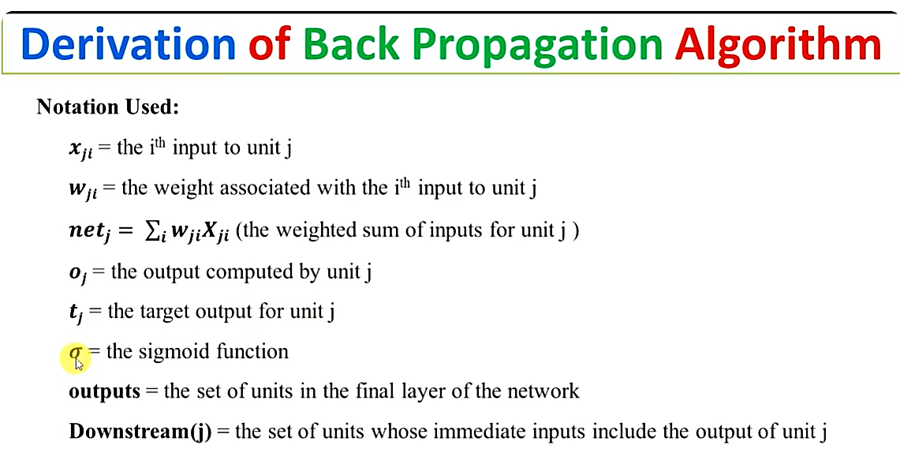

Slide 12
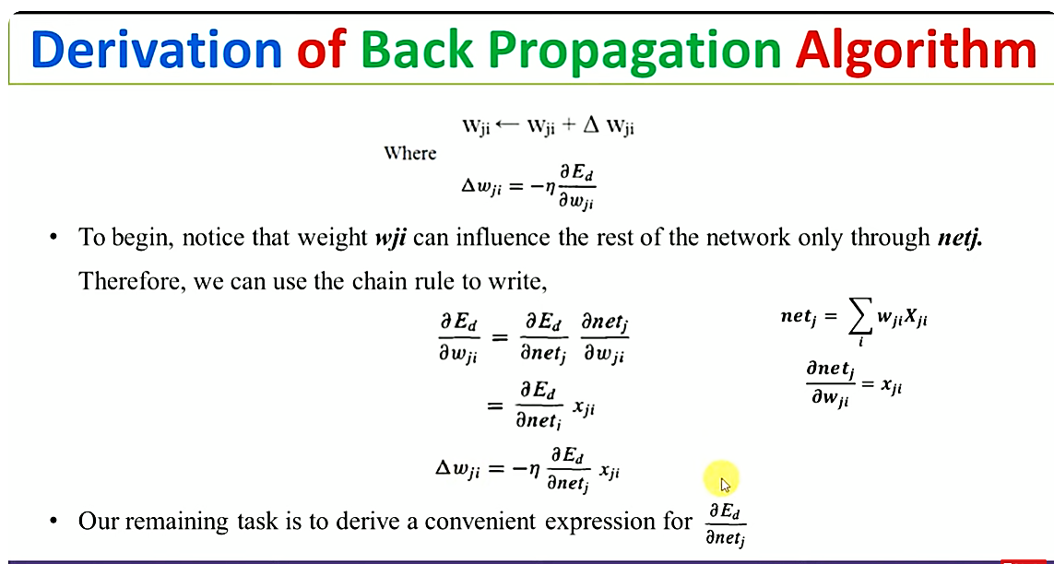

Slide 13
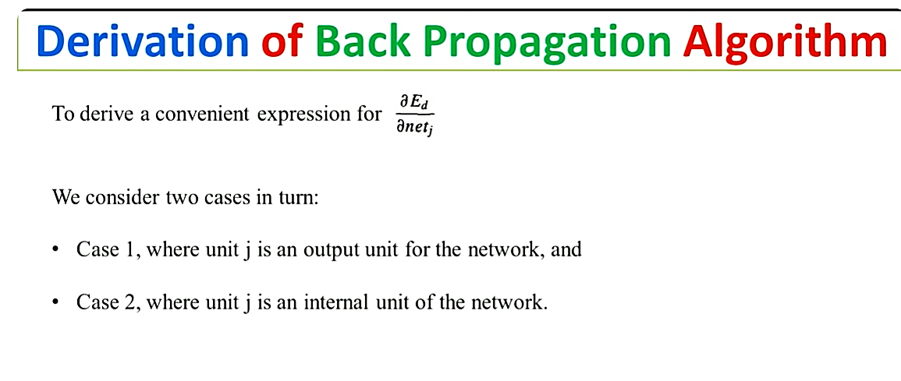

Slide 14
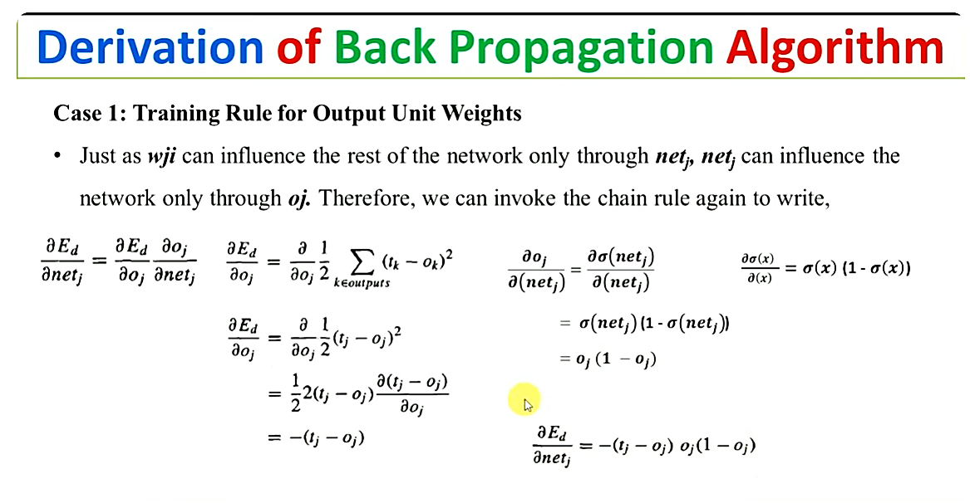

Slide 15
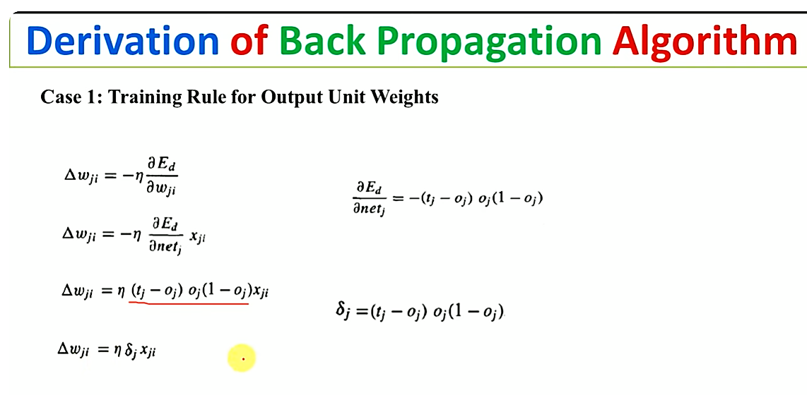

Slide 16
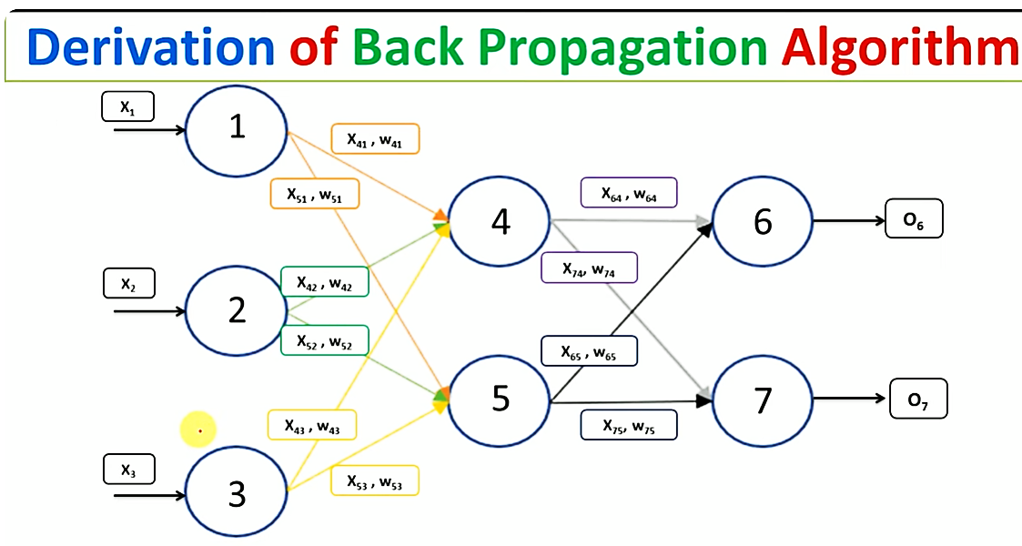

Slide 17
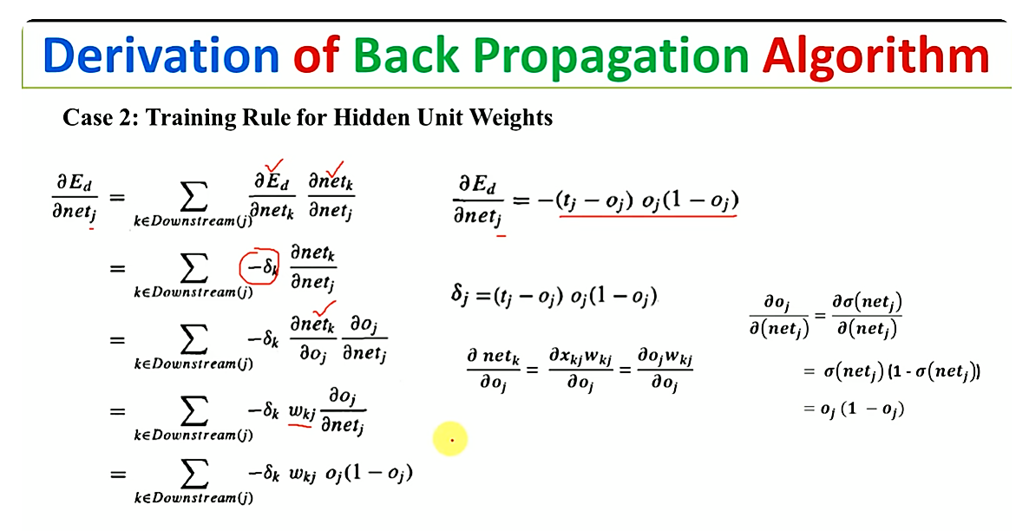

Slide 18
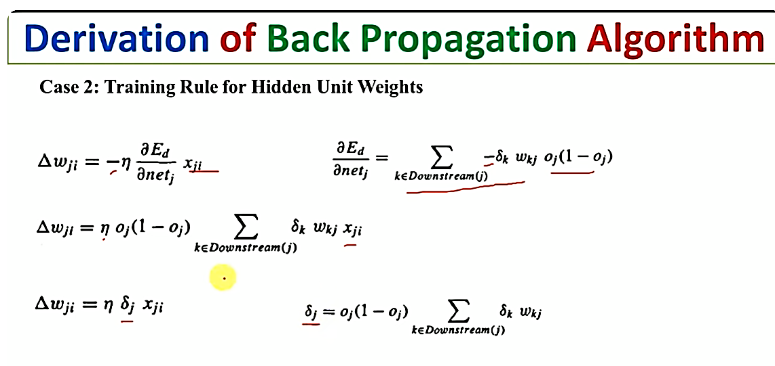

Slide 19
Thank You

